Slide 1
IML Presentation
Group 8
Marwa Madni
BSCIS 18-22

Slide 2
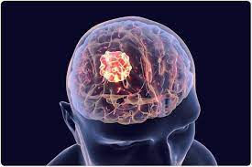
What is the Problem?
The task is to classify a given MRI scan into one of the two types
of cancers; Meningioma and Glioma

Slide 3
Why does the problem need to be solved?
A brain tumor is one of the most dangerous diseases .
The detection of Brain tumor has to be done as soon as possible due to the confidential medical treatment.
Magnetic Resonance Imaging (MRI) is one of the medical tools for detecting brain tumors by scanning the head area of the patients.

Slide 4
How I solved the Problem:
Data Access from Figshare
Data Extraction
Feature Extraction Through glcm
Heatmap of Features
Spot Algorithms
Accuracies

Slide 5
Dataset
This brain tumor dataset containing 3064 T1-weighted contrast-inhanced images from 233 patients with three kinds of brain tumor: meningioma (708 slices), glioma (1426 slices), and pituitary tumor (930 slices).
I have ignored pituitary tumor (930 slices)..

Slide 6
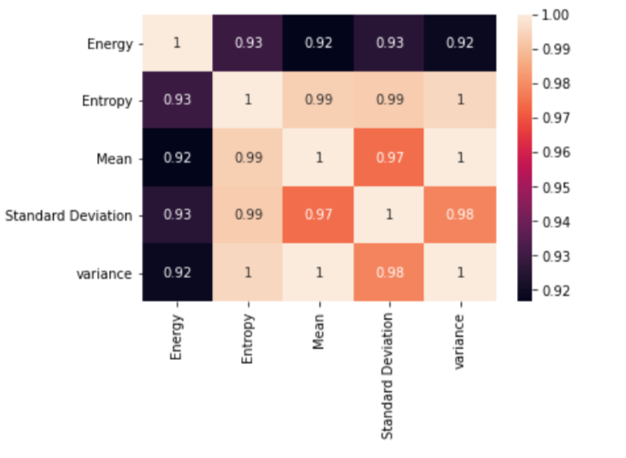
Heatmap of Features

Slide 7
Spot Algorithms and Classification Reports

Slide 8
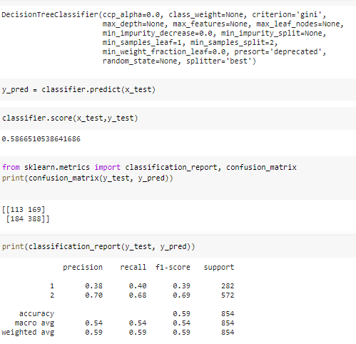
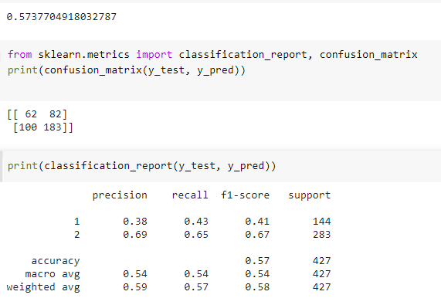
Decision Tree

Slide 9
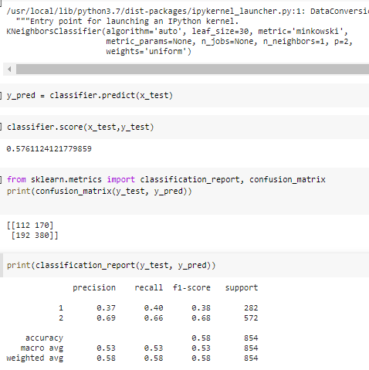
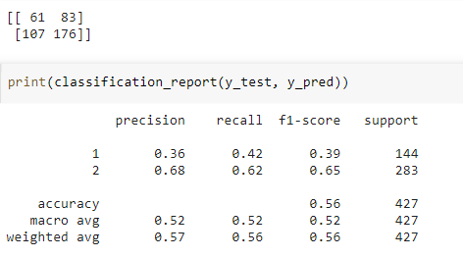
KNN 1-N

Slide 10
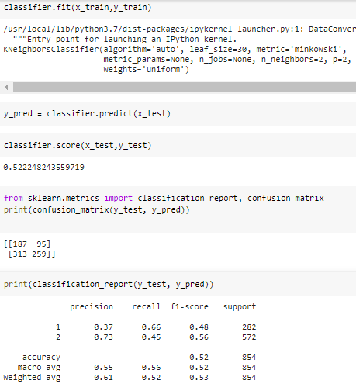
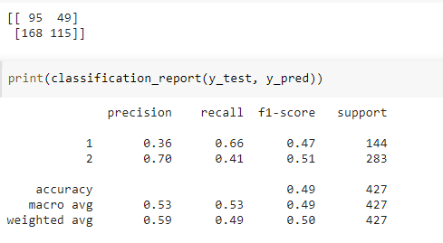
KNN 2N

Slide 11
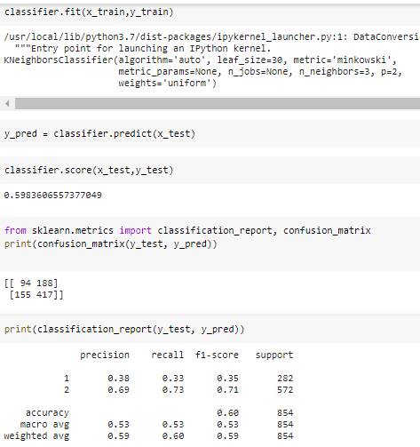
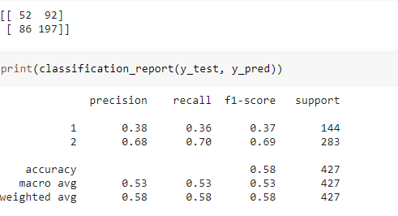
KNN 3N

Slide 12
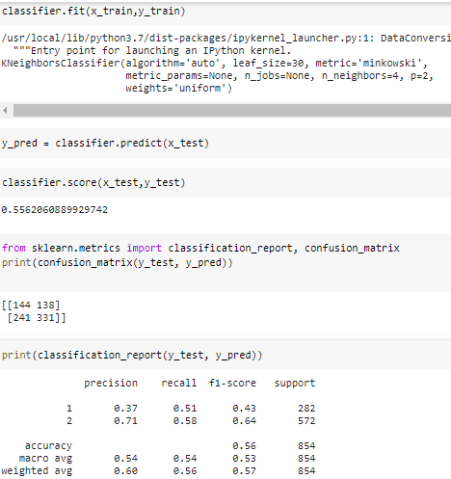
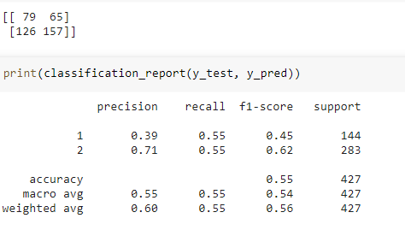
KNN 4n

Slide 13
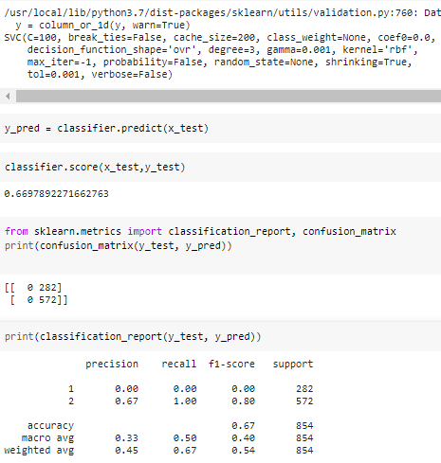
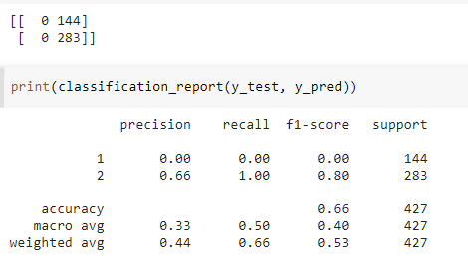
SVC

Slide 14
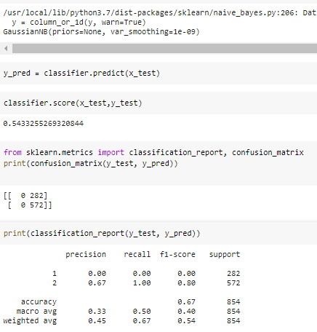
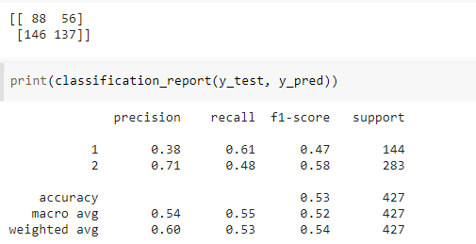
GaussianNB

Slide 15
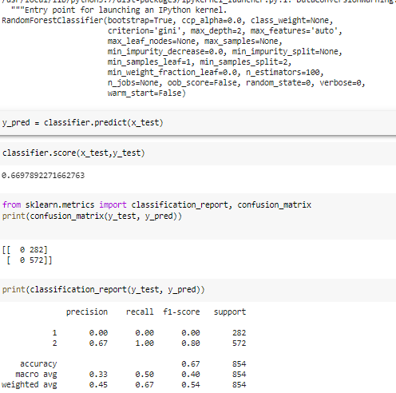
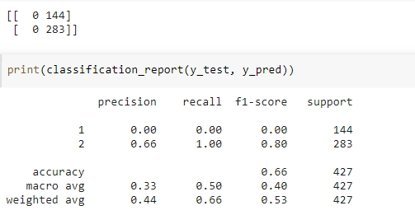
RandomForest

Slide 16
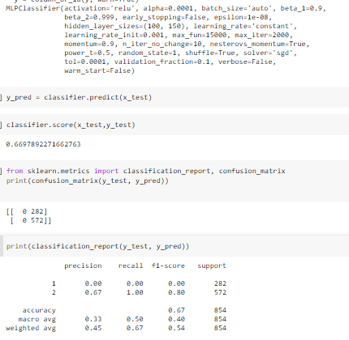
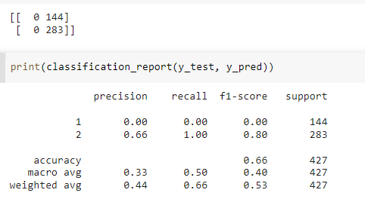
MLP Classifier

Slide 17
 | Accuracy | Confusion Matrix | Confusion Matrix
Decision Table | 59 | [[113 169] [184 388 ]] | [[62 82] [100 183]]
KNN 1n | 58 | [[112 170] [ 192 380]] | [[61 83] [107 176]]
KNN 2n | 52 | [[187 95] [313 259]] | [[95 49] [168 115]]
KNN 3n | 60 | [[94 188] [155 417]] | [[52 92] [86 197]]
KNN 4n | 56 | [[144 138] [241 331]] | [[79 65] [125 157]]
SVC | 67 | [[0 282] [0 572]] | [[ 0 144] [ 0 283]]
GaussianNB | 67 | [[0 282] [0 572]] | [[88 56] [146 137]]
RandomForestClassifier | 67 | [[0 282] [ 0 572]] | [[ 0 144] [ 0 283]]
MLP Classifier | 67 | [[0 282] [0 572]] | [[ 0 144] [ 0 283]]

Slide 18
Thanks

